Slide 1

Jacksonville Waterways Commission
December 11, 2019
“The city should cultivate a culture that proclaims the great attributes of our rivers and ocean.”
By Commissioner Jill Haskell

Slide 2
Boater’s Skip Day
2019
What is it? A loosely coordinated grouping of boaters that meet at Bayard Point.
It is rapidly becoming the premiere boating event in NE Florida.
It occurs annually on the second Friday in June.
An interview with Lisa Almeida “The Boatanista”:
https://www.firstcoastnews.com/video/news/local/hundreds-of-boaters-participated-in-boater-skip-day-in-green-cove-springs/77-e2250422-b729-4719-8bfc-617ea705c4b9

Slide 3
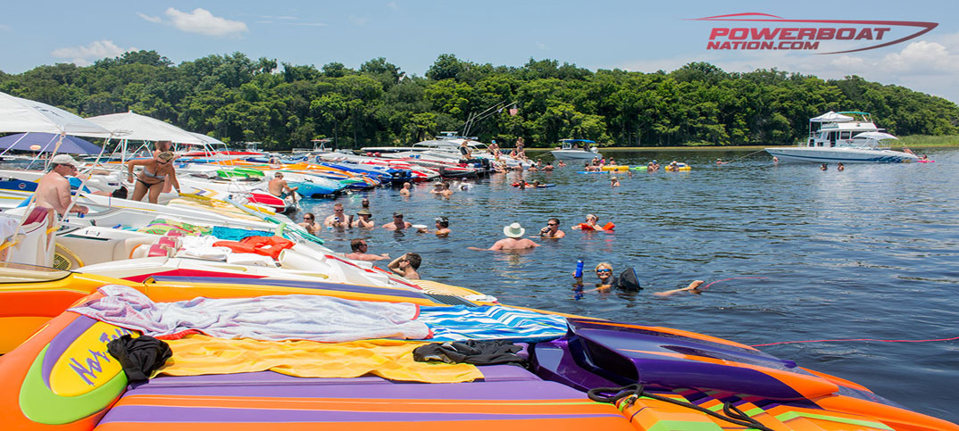
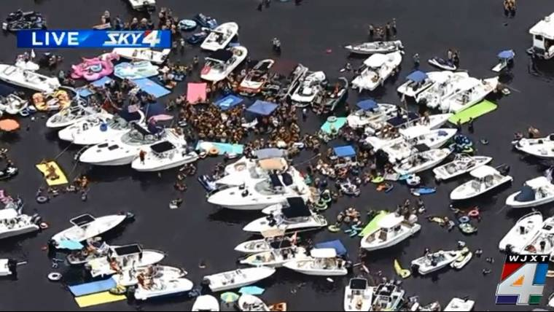
2014 Performance Boats & Locals
It’s Growing!!
Facebook Events from June 7th 2019 records that 1.6K people attended
Folio Weekly reported: Jesse Dowling, owner of the SOS Diner is quoted:
“Now in its fifth year, the event has grown from mere dozens to hundreds of boats. This year’s gathering is predicted to be bigger than ever. “
https://www.facebook.com/WJXT4TheLocalStation/videos/454309765332343/
(Start video at 1min)
2019 A Great Variety of Boats

Slide 4
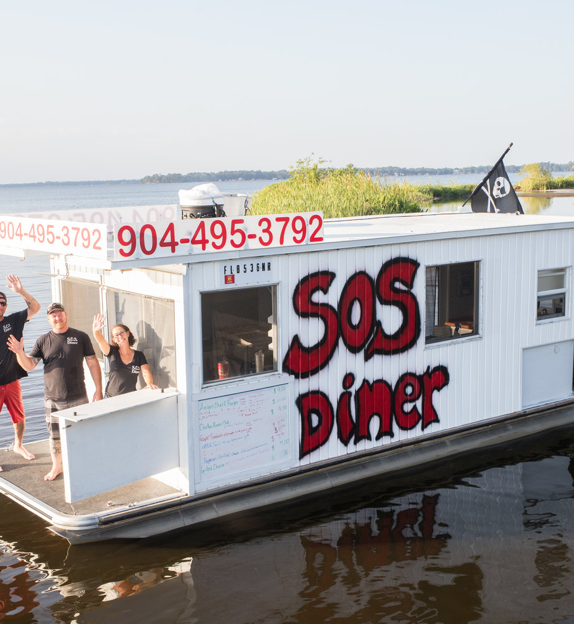
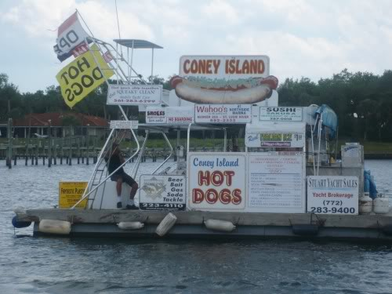
Economic Impact
***Jesse Dowling, of the SOS Diner, talks about the business of Boater’s Skip Day:
“Once we start serving, we don’t stop until people start leaving,” Dowling said. “It was kinda slow going at first, but now it’s a monster. Now everybody knows. We’re feeding them when they get there and feeding them when they leave.”
***Boats and guests buy fuel, ice, drinks and supplies from local businesses.

Slide 5
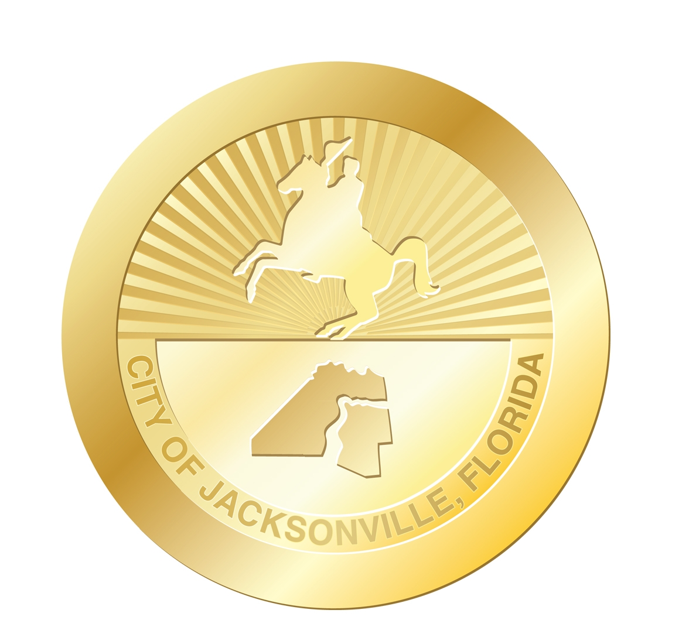
Task: “The city should cultivate a culture that proclaims the great attributes of our rivers and ocean.”
***Facebook Comments***
Travis Napier, that's a lot of people for an event we have never heard of. Ha
David Sage · 1:03 Ashley Lee Evans why we need a boat lol
Elizabeth Dale Poston · 1:12 Where at in the water
· Andres G. Falcon · 1:13 Next time we have to be there Brandon Smith
Becky Henderson Smith · 1:22 Best BSD yet!! Chris Verderane
We already have some of these activities, we need to diversify & celebrate them on a grander scale:
People are unaware of boating events that occur on local waters
City government support would help bring media attention to BSD and other on-water events
Special Events has a data base of boater’s information
COJ could provide printed materials for distribution & advertising

Slide 6
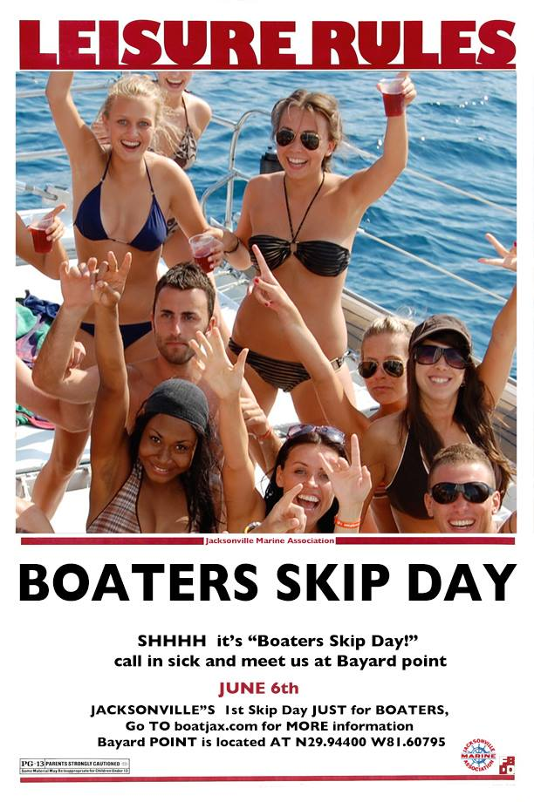

Slide 7
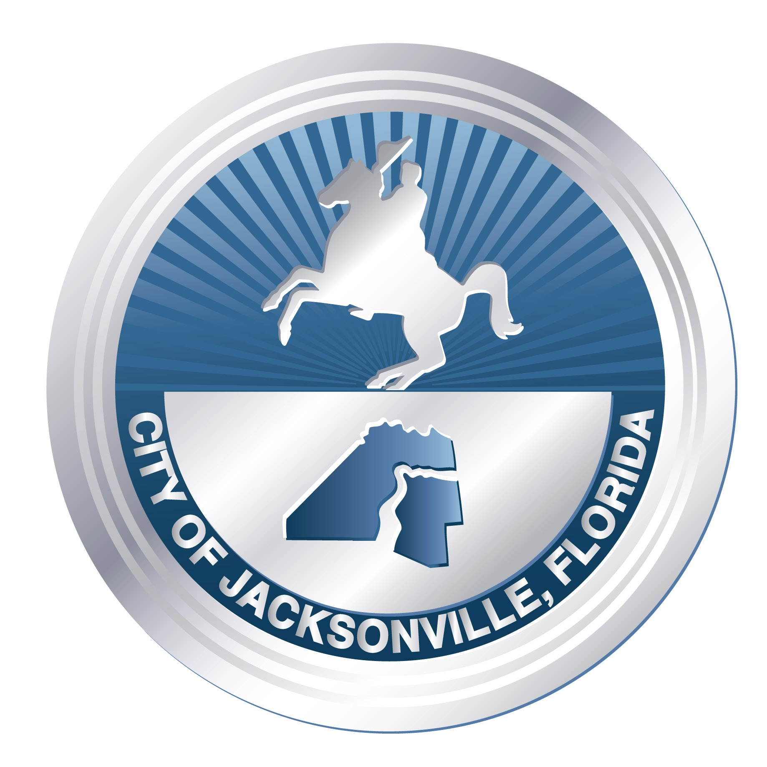
Let’s Make it Official
There were 128 Mayoral proclamations in 2018
There were 104 Mayoral proclamations in 2019 (January thru November)
Only 2 were related to Maritime Activites
(Honoring the El Faro and Maritime Day)
“The Mayor's Office issues proclamations to recognize the contributions of organizations and individuals in Jacksonville, as well as to increase awareness for significant issues or important events throughout the city.” COJ.net

Slide 8
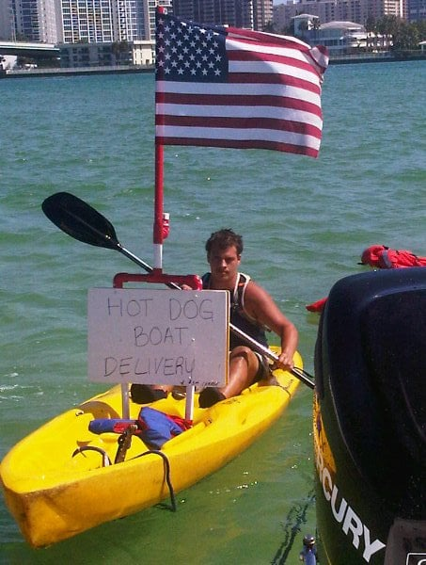
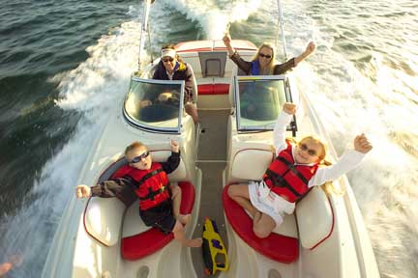
Support a Mayoral Proclamation
to designate the Second Friday in June
as BOATER’S SKIP DAY!

